Slide 1
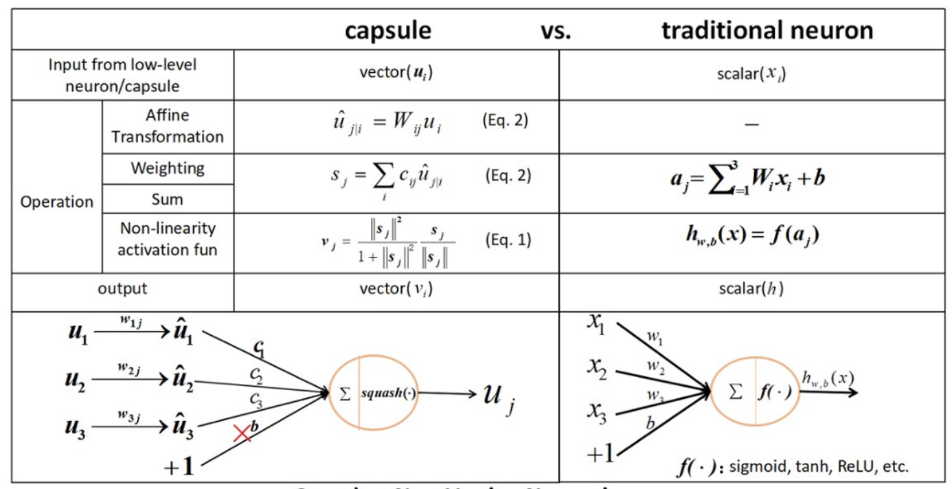

Slide 2
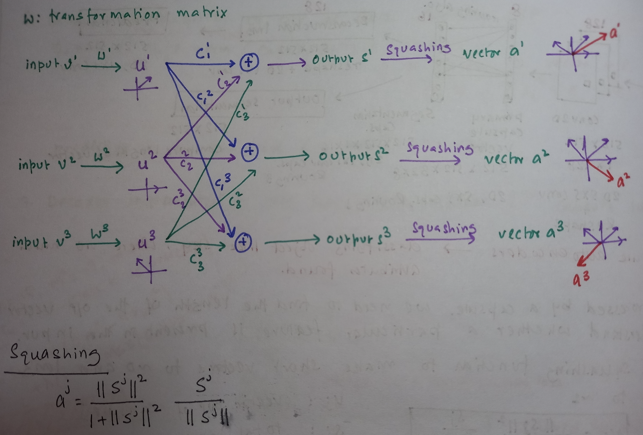
How CapsNet works

Slide 3
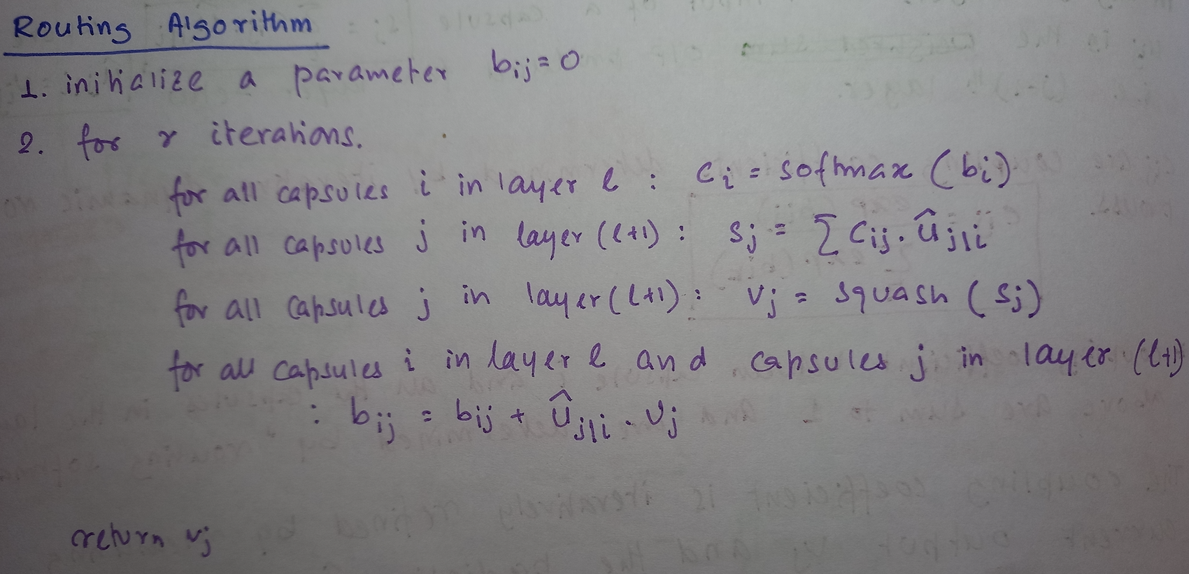
Dynamic routing in capsnet

Slide 4
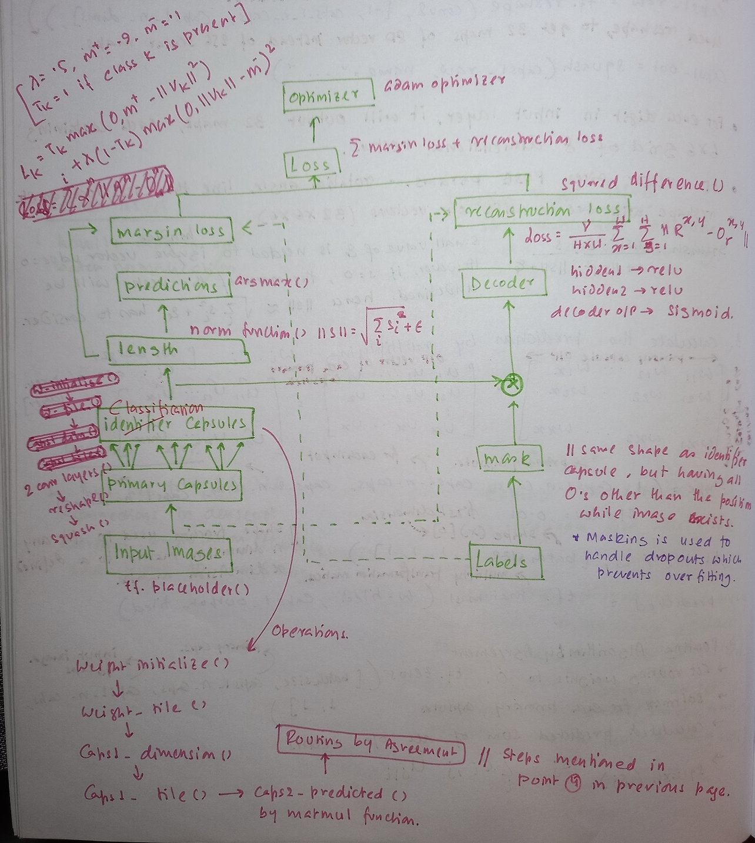
Implementing capsnet

Slide 5
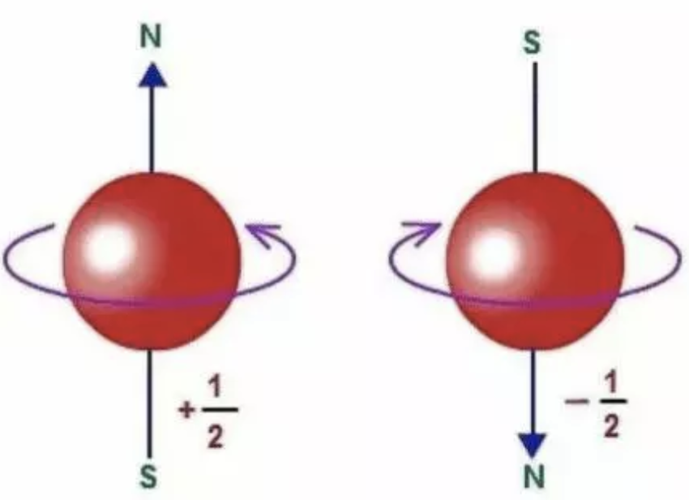
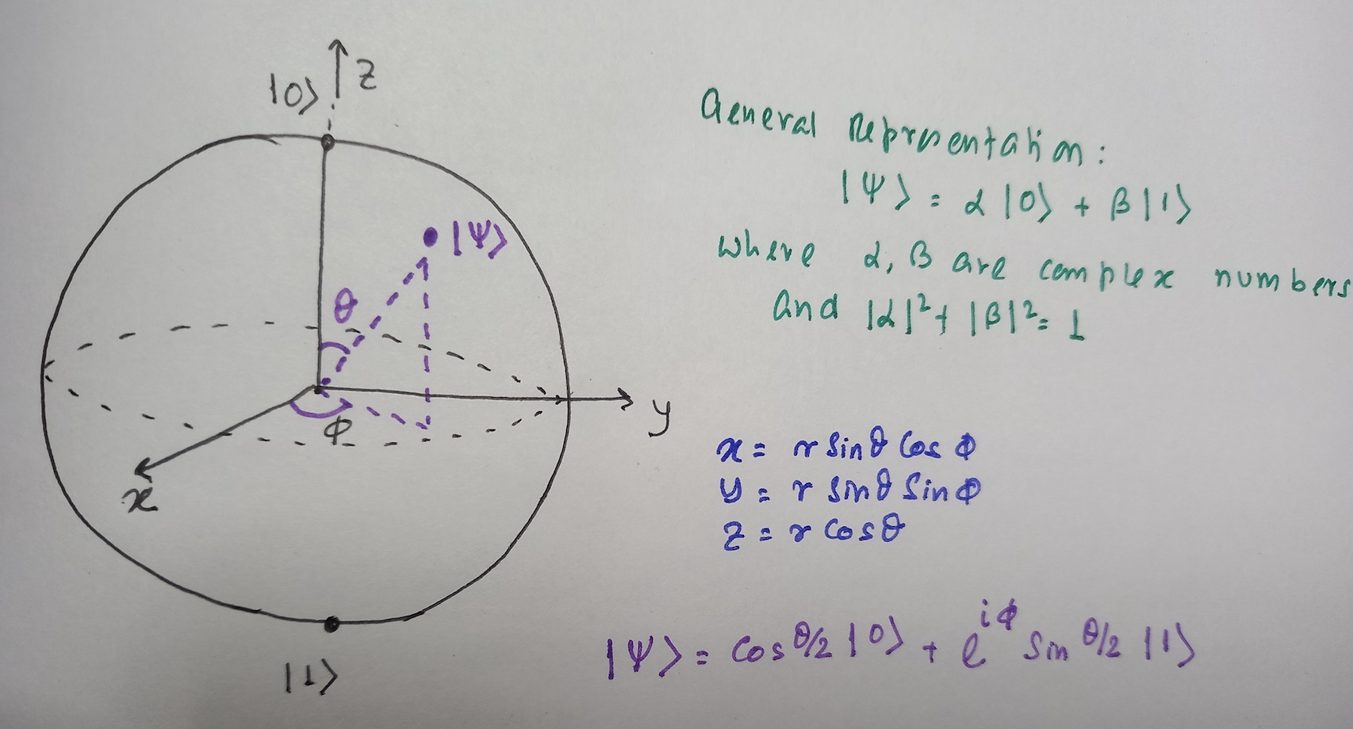
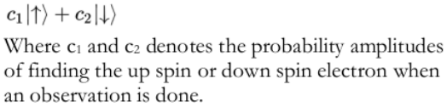
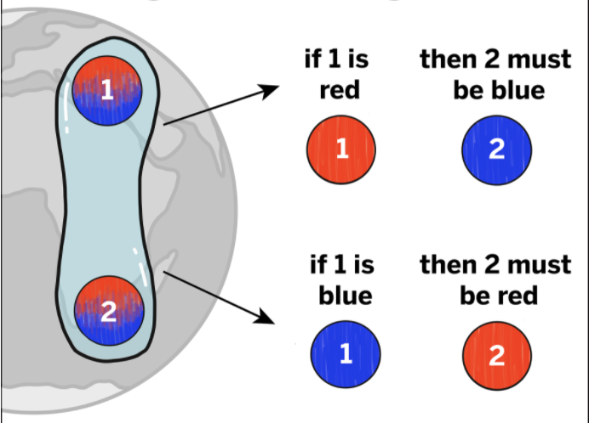
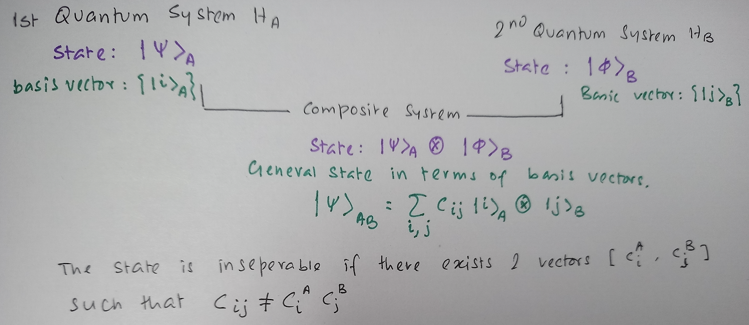
superposition and entanglement and qubits
quantum mechanics allows the qubit to be in a coherent superposition of both states simultaneously
Synthetic ions with large coherence and natural ions with less coherence
System exists in separate quantum state at the same time
quantum states of two or more objects have to be described with reference to each other, even though the individual objects may be spatially separated

Slide 6
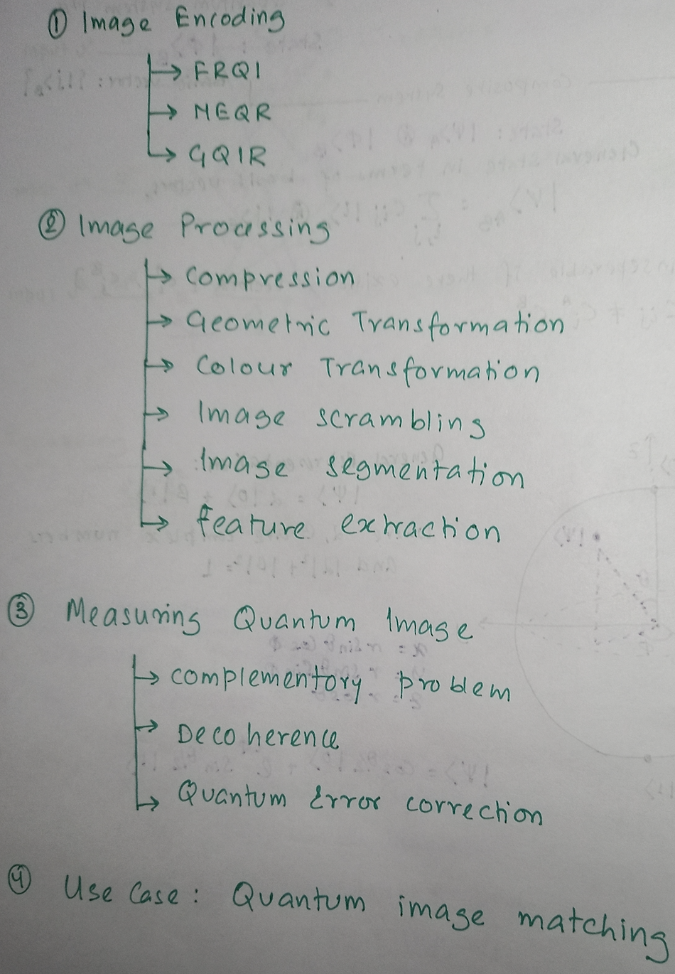
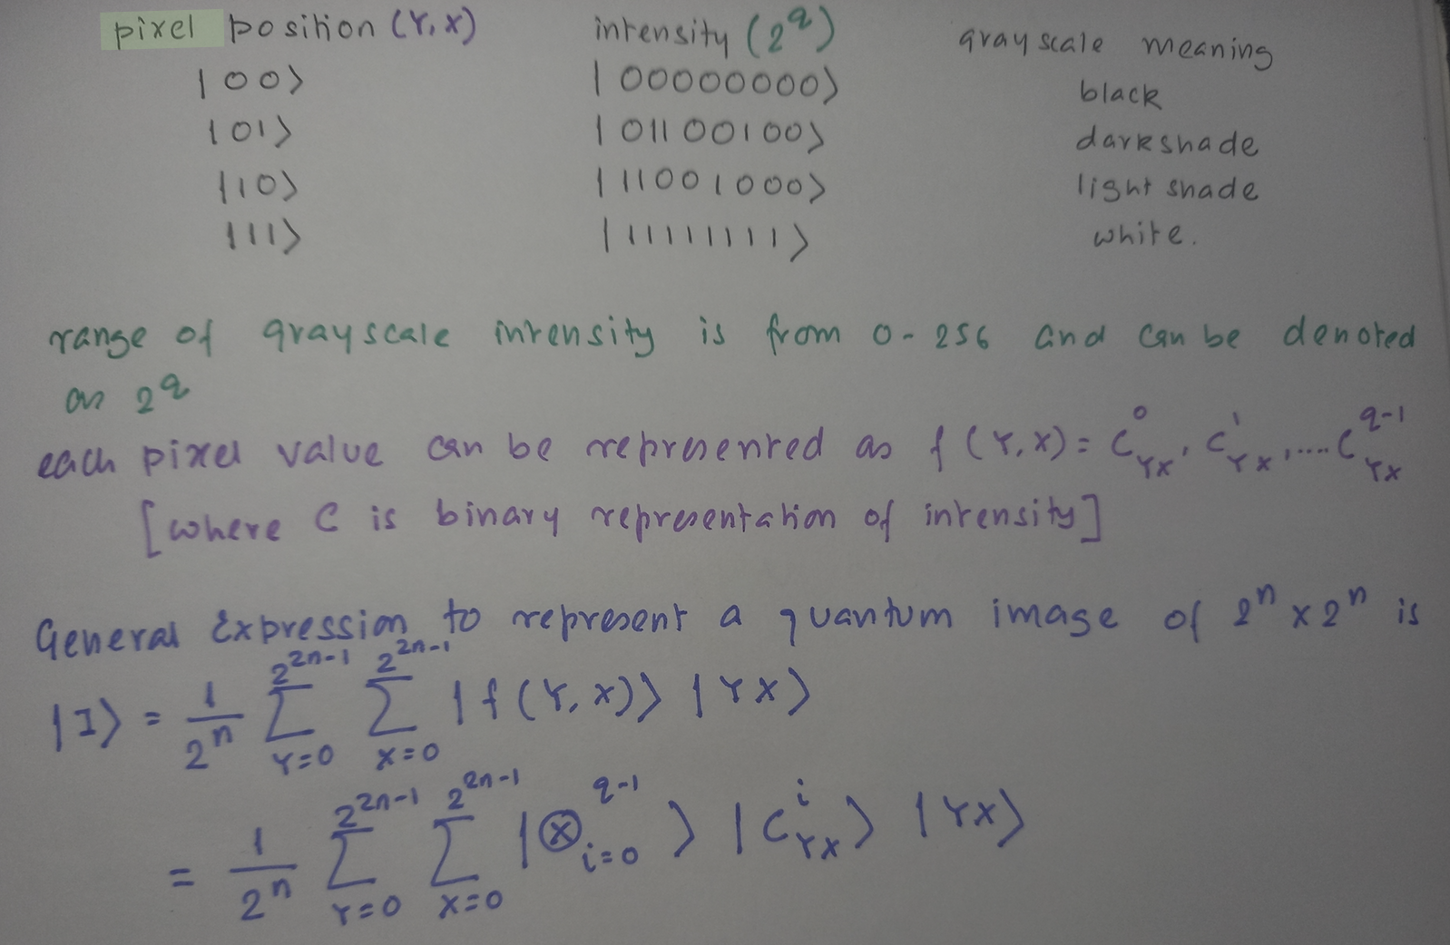
Quantum image processing steps : Encoding Image

Slide 7
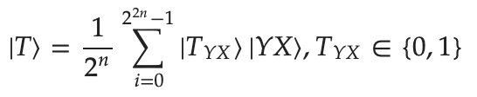
Quantum image processing steps : Image transformation
Basic idea of image compression is to reduce the number of quantum gates by simplifying Boolean expressions and
by reducing the number of qubits representing a quantum image
Fast geometric transformations such as the two-point swapping, flip, co-ordinate swapping, orthogonal rotations and
their variants for quantum images, are proposed using the basic quantum gates, NOT, CNOT and Toffoli gates.
Based on the characteristics of the FRQI representation, a general form of the colour related transformations
Can be carried out by single qubit gates such as X, Z, and H gates
The global scrambling partitions the target image into m ×n sub-blocks by performing the permutation operation
with the CNOT gate and NOT gate.
Image segmentation is achieved by using an operator prepared by an orthogonal basis and the grey level information
encoded into the ground state of the quantum state to make an equivalent determination
Feature extraction
Step1:quantum segmented images are obtained by coordinate transformation
Step2: The gradient of the pixel is calculated by Kirsch operator
Step3: The gradient is classified by the threshold operation
Step4: from the final output of the quantum state
When 𝑇_{𝑌𝑋}=1means edge point, otherwise not

Slide 8
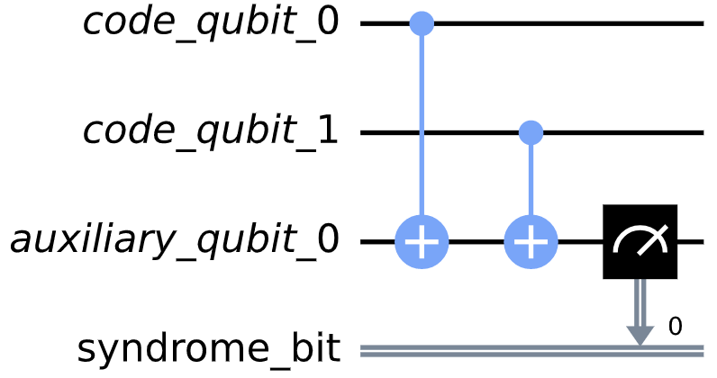
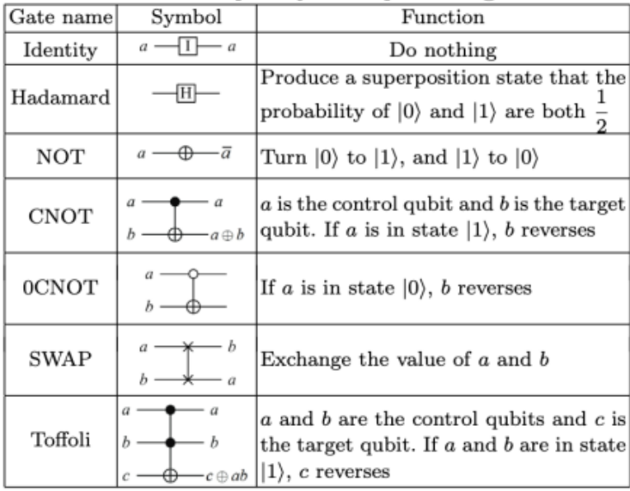
Quantum image processing steps : Error correction
Peter Shor first discovered this method of formulating a quantum error
correcting code by storing the information of one qubit onto a
highly entangled state of nine qubits.
A syndrome measurement can determine whether a qubit has been
corrupted, and if so, which one.
decoherence
qubits
qubits
Quantum gate₁
Quantum gate_{n}
Quantum registers
Operations for error corrections:
Bit Flip
Sign Flip
Shor code, which corrects both bit and phase flip
coherence

Slide 9
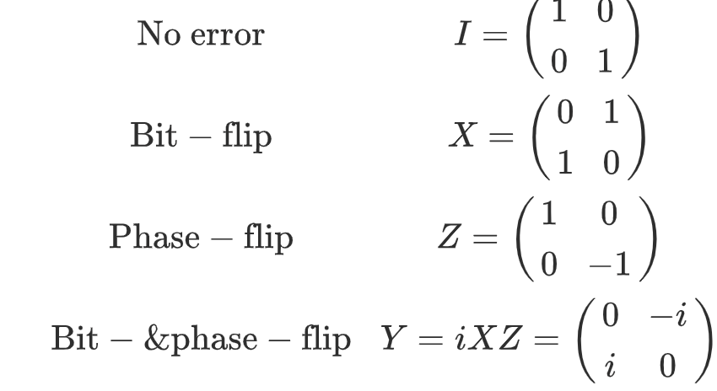
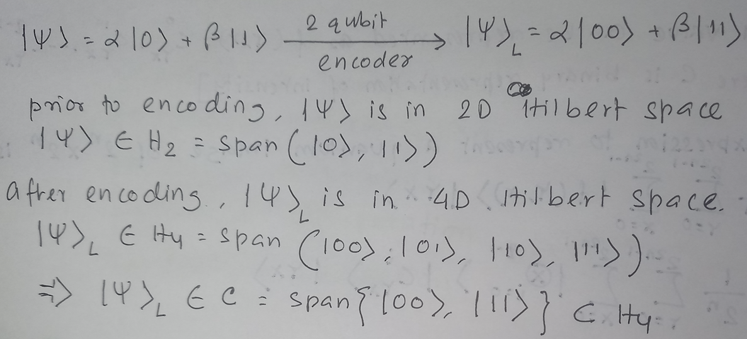
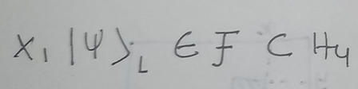
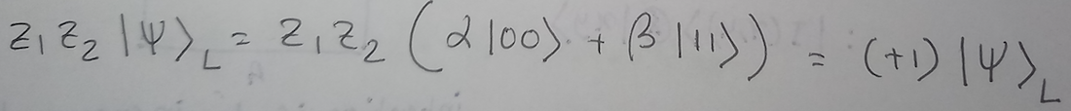
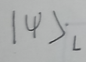
Quantum image processing steps : Error correction
The four Pauli operators, I, X, Z, Y, allow us to express the four possible effects of the environment on a qubit in the state,
|ψ〉 = α₀|0〉 + α₁|1〉
Data can’t be cloned
Both X and Z errors can happen together
Step1 : encode data in high dimension Hilbert Space
Stpe2 : consider the error
Error can happen for X, Y or Z
Where F is called the error subspace
Step3 : measuring the errors
As C and F are mutually orthogonal, it is possible
to distinguish in which subspace the logical qubit
exists by projective measurement.
C is called as code subspace
z₁z₂ is stabilizer measurement operator
** a quantum code distance is the minimum size error that goes undetected
Stabilizer Codes :
A stabilizer code can be represented by [n,k,d] where n is number of qubits, k is number of logical qubits and d is code distance.
They must be Pauli group elements
They must stabilize all logical state

Slide 10
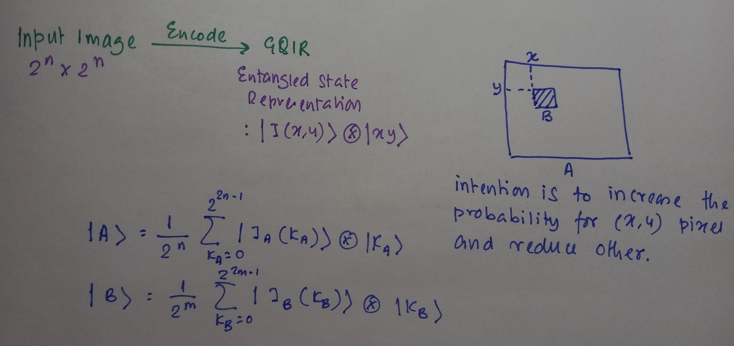
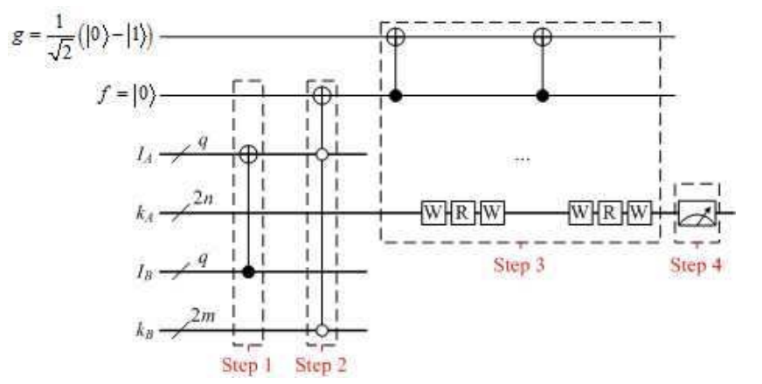
Quantum image processing use case : image matching
Step 1 Find out the matched area,
i.e., the pixels that IA = IB.
Step 2 Find out the upper left corner
of the matched area
Step 3 Change the probability of
subspace based on Grover’s algorithm
Step 4 Measurement.

